Slide 1
Uncertainty Quantification in Deep Learning
Case Study
Mid-Term Presentation
TU Dortmund 14.05.2024

Slide 2
Groups Introduction
Bayesian Neural Network
Farmal
Zafar
Posterior Network
Muhammad Farhan
Ikhtiar
Zeynep
Repulsive Deep Ensembles
Hamza
Mustafiz
SNGP
Simin
Ramit
Eylül

Slide 3
Contents
Motivation and Introduction
Methods Description
2.1 Bayesian Neural Networks
2.2 Posterior Network
2.3 Repulsive Deep Ensembles
2.4 SNGP
Method Similarities
Dataset Interpretation (We will use)
Conclusion
Q&A Session
Notes:
-Calibri,white headings

Slide 4
Motivation
Uncertainty quantification in deep learning refers to the process of understanding and estimating the uncertainty associated with predictions made by deep learning algorithm.
Objective: Evaluate methods for quantifying uncertainty in deep learning.
Importance: Crucial for safe AI deployment in high-stakes environments.
Robust Decision Making: Instead of blindly trusting model outputs, decision-makers can take into account the level of confidence or uncertainty associated with each prediction.
Reliability Estimation: For applications such as autonomous driving or the analysis of medical imaging results, the predictions are relevant for the safety of road users or the patient, uncertainty estimates are essential.
Notes:
zafar/farmal 2min

Slide 5
Types of Uncertainty
Aleatoric Uncertainty
Caused by inherent randomness or noise in the input data.
It describes the influence of the stochastic input data noise, and therefore cannot be reduced with more training data.
Also known as data uncertainty.
Epistemic Uncertainty
Systematic uncertainty that arises from a lack of knowledge or understanding within the model.
It is reducible through better model training.
It increases for new input data not seen in the training process.
Also known as model uncertainty.

Slide 6
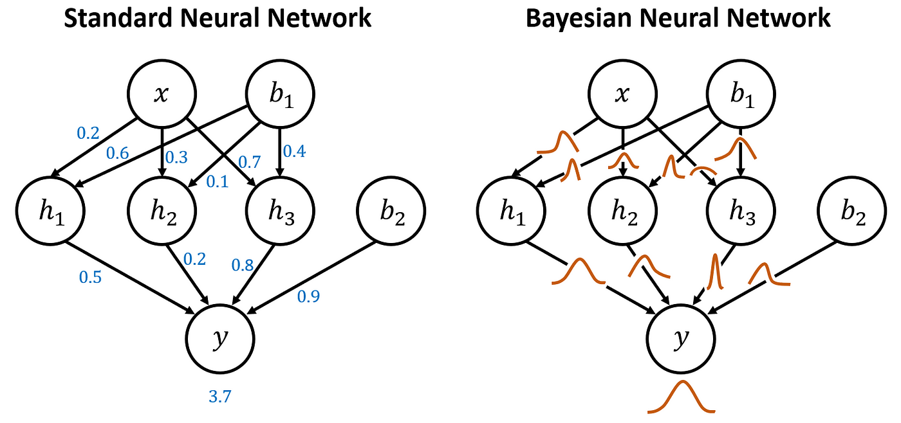
2. Methods Description
2.1 Bayesian Neural Networks
A Bayesian neural network (BNN) is a type of deep learning network that uses Bayesian methods to quantify the uncertainty in the predictions of a deep learning network.
It employs statistical methodology so that everything has a probability distribution attached to it, including model parameters (weights and biases in neural networks).
BNNs extend traditional neural networks by treating model parameters as random variables with associated probability distributions.
Notes:
6mins

Slide 7
2.1 Bayesian Neural Networks
Working
In BNN we can model the weights and biases as random variables that will give us a different value every time we access it.
This process of getting a new value from a random variable is called sampling. What value comes out depends on the random variable’s associated probability distribution.
To model the weights and biases using a distribution rather than a single deterministic set, we define a probability distribution for the weights. This can be achieved using Bayes' theorem:
P(parameters ∣data) = (P(data∣parameters) × P(parameters)) / P(data)
Each set of weights corresponds to a different possible configuration of the network, reflecting the uncertainty in the parameters.

Slide 8
2.1 Bayesian Neural Networks
Benefits and Limitations
Bayesian neural nets are useful for solving problems in domains where data is scarce, as a way to prevent overfitting. Example applications are molecular biology and medical diagnosis (areas where data often come from costly and difficult experimental work).
Natural approach to quantify uncertainty (less often overconfident or underconfident than general NNs).
Training BNNs can be computationally intensive and time-consuming, particularly for large datasets and complex models.

Slide 9
2.1 Bayesian Neural Networks
Sampling Based Inference (SBI) Methods
Using SBI methods, we can take samples from the posterior distribution to generate multiple sets of weights instead of using a single set of weights to make predictions.
Markov Chain Monte Carlo methods: These methods sample from the posterior distribution by constructing a Markov chain (or multiple chains) that converges to the stationary distribution.
Variants of MCMC methods:
Hamiltonian Monte Carlo (HMC): The algorithm uses Hamiltonian dynamics to sample from probability distributions efficiently.
No-U-Turn Sampler (NUTS): An extension of HMC that automatically tunes its parameters and dynamically adapts the number of steps.
Notes:
NUTS adv: improving sampling efficiency and reducing the need for manual tuning.

Slide 10

2.1 Bayesian Neural Networks
Posterior Predictive Density
The posterior predictive density refers to the distribution of predictions for new data points given the observed data and the uncertainty in the model parameters.
Formula:
p(y*|x*, D): Predictive distribution of new observations given data.
p(y*|x*, θ): Likelihood of new observations given parameters and data.
p(θ∣D): Posterior distribution of parameters given data. (use Bayes theorem)

Slide 11


2.1 Bayesian Neural Networks
Log Posterior Predictive Density (LPPD)
Since the previous equation lacks a closed form solution we can rely on Monte Carlo estimates:
The LPPD quantifies how well, on average, the predictive distribution covers the observed labels.
Higher LPPD values indicate lower uncertainty, as the model is more confident in its predictions and vice versa.
Notes:
Compute Monte Carlo estimate: Approximate the integral by averaging the likelihood function evaluated at the generated data points. S is the number of samples.

Slide 12
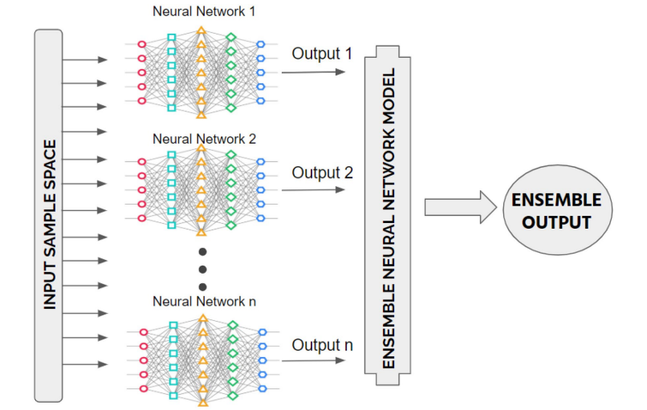
2.1 Bayesian Neural Networks
Bayesian Deep Ensembles (BDEs)
Multiple BNNs are trained independently on the same dataset, each with different initializations or subsets of the data.
Each BNN in the ensemble provides a different estimate of the posterior distribution over the parameters.
Predictions are then obtained by averaging the predictions of all BNNs in the ensemble, providing uncertainty estimates as well with LPPD value of each network.

Slide 13
2.1 Bayesian Neural Networks
Bayesian Deep Ensembles (BDEs)
Benefits:
Increases LPPD values leading to low uncertainty.
BDEs can provide more robust and generalizable predictions that reduces overfitting.
Flexible in different model architectures including CNNs, RNNS.
Limitations:
Scaling BDEs to very large datasets or high-dimensional input spaces can be challenging.
Computationally expensive and significant memory resources required.

Slide 14

2. Methods Description
2.2 Posterior Network
Posterior Network (PostNet) uses an innovative approach to uncertainty estimation that leverages normalizing flows and Bayesian principles to model the uncertainty associated with each prediction, particularly focusing on out-of-distribution (OOD) data.
Key Insight: Unlike traditional methods, PostNet does not require OOD samples during training, which makes it highly applicable in real-world scenarios where OOD samples are not readily available.

Slide 15
2.2 Posterior Network
Methodology of PostNet
Epistemic and Aleatoric Uncertainty: Explanation of how PostNet distinguishes between these types of uncertainties to provide robust predictions.
Dirichlet Distribution: Discuss how PostNet uses the Dirichlet distribution to parametrize the uncertainty in predictions, detailing the model's ability to provide a closed-form solution for both epistemic and aleatoric uncertainties.

Slide 16
2.2 Posterior Network
Components & Working
Encoder: Maps input data into a latent space, capturing the essential features relevant to uncertainty estimation. | Normalizing Flow: A sequence of invertible transformations that learns a complex distribution over the latent space, crucial for accurate density estimation.
Bayesian Loss: Optimizes the parameters of PostNet by aligning the predicted distributions with the true data distributions using a Bayesian updating framework. | Operational Flow: Visual diagram or flowchart showing how data flows through these components during training and inference to estimate uncertainty.
How it works? Maps inputs into latent space, estimates density via normalizing flows, and uses density estimations to parameterize a Dirichlet distribution for uncertainty quantification.

Slide 17
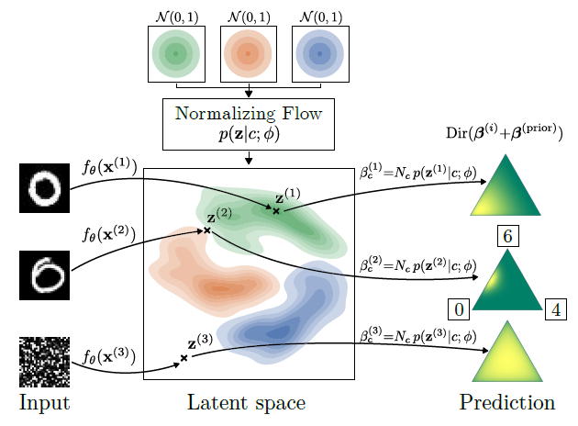
Overview of Posterior Network

Slide 18
2.2 Posterior Network
Hyperparameters
Learning Rates: Importance of choosing the right learning rate for stability and convergence.
Normalizing Flow Parameters: Discussion on the choice of the type of flow (e.g., radial flow or IAF) and their impact on model performance.
Regularization Techniques: How various regularization techniques are applied to prevent overfitting and ensure generalizability.

Slide 19
2.2 Posterior Network
Benefits and Limitations
Benefits
High Accuracy and Robustness in OOD Detection: Outperforms traditional methods by effectively detecting OOD samples and providing reliable uncertainty estimates.
Scalability: Efficient in terms of computation, especially compared to methods requiring extensive sampling.
Limitations
Complexity in Tuning: Requires careful calibration of hyperparameters and understanding of underlying statistical models.
Computational Demand: While generally efficient, the complexity of normalizing flows can lead to higher computational costs compared to simpler models.

Slide 20
2. Methods Description
2.3 Repulsive Deep Ensembles
Paper aims to solve the Non-identifiability of neural networks.
Empirical test error of the ensemble converges to the one of a single trained model when the number of parameters goes to infinity.
Method Family Particle-Optimization Variational Inference (POVI), Inspired by SVGD, which aims to decrease the KL divergence between the particle-approximated distribution and the target posterior distribution.

Slide 21

Methods of this paper
Repulsive Force in Weight Space:
To overcome the limitations of standard deep ensembles, the authors introduce a repulsive term inspired by Stein Variational Gradient Descent (SVGD).
This repulsive term models the interaction between ensemble members using a kernel function, causing the members to repel each other in weight space to avoid collapsing to the same solution.
The repulsive term is added to the gradient update rule for the ensemble members, taking the form:

Slide 22
Repulsive Force in Function Space:
To overcome the overparameterization issue, the authors also consider formulating the repulsive term in function space instead of weight space.
This involves modeling the interaction between ensemble members as particles in function space, using a kernel to capture the repulsion between functions.
The update rule in function space takes the form:

Slide 23
Repulsive Deep Ensembles are Bayesian:
Choosing the repulsive term appropriately, the update rules for the repulsive deep ensembles can be interpreted as a discretization of the gradient flow dynamics of the KL divergence in Wasserstein space.
This means that the repulsive deep ensembles can be seen as performing proper Bayesian inference, converging to the true Bayesian posterior in the limit of infinitely many ensemble members.

Slide 24
Benefits
Prediction accuracy is increased by adding a kernelized repulsion between ensemble members.
Functional repulsion among ensemble members can improve the quality of out-of-distribution detection on real-world data and estimated uncertainty
on basic synthetic instances.
This provides a simple and principled way to improve upon standard deep ensemble methods, which are not well-understood in terms of their Bayesian interpretation.

Slide 25
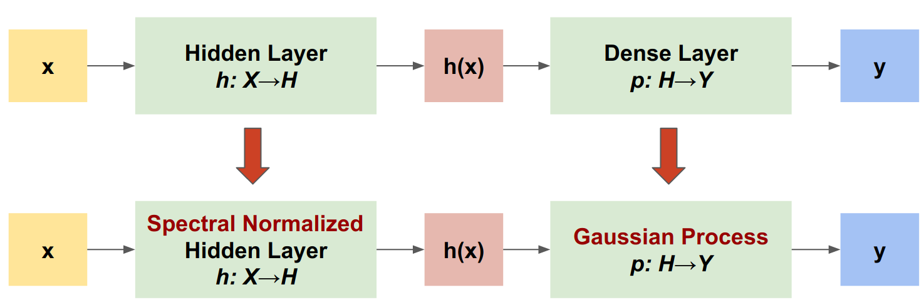
2.4 Introduction to SNGP
<Simple and Principled Uncertainty Estimation with Deterministic Deep Learning via Distance Awareness>
Given a deep residual network, SNGP makes two simple changes to the model:
It applies spectral normalization to the hidden residual layers.
It replaces the Dense output layer with a Gaussian process layer.

Slide 26
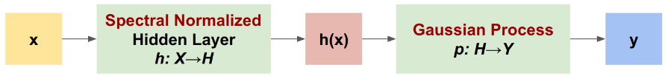




2.4 Distance Awareness
Distance Preserving
Distance Aware
RFF:
Mapping a kernel function to a low-dimensional space.
Laplace Approximation:
Approximating the posterior distribution with a Gaussian distribution
Bi-Lipschitz
- Achieving this by applying spectral normalization to the weight matrices.(largest singular value less than 1)
- Keeping the relative distance, ensuring that the function is contractive.

Slide 27
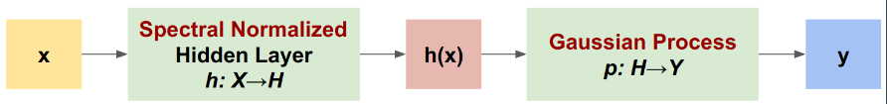
2.4 Methodology of SNGP
Distance Preserving
Distance Aware
Distance-preserving Hidden Mapping:
Applies spectral normalization to control the Lipschitz constant of the layers, ensuring meaningful distances are preserved through deeper layers of the network.
Distance-aware Output Layer:
Replaces traditional dense output layers with a GP using an RBF kernel, enhancing the model's ability to judge distances in feature space.
Employs Laplace approximation for scalability in training and prediction.

Slide 28
2.4 Hyperparameters
SN contains two hyperparameters-
Number of power iterations(can be fixed to one.)
Upper bound for the spectral norm.(Controls the tradeoff between expressiveness and distance awareness)
GP layer consists of three hyperparameters
Hidden dimension (Dl, i.e no. of hidden features )
The length scale parameter of the RBF kernel.
Strength of the regularization on the output weights

Slide 29
2.4 Hyperparameters(continued.)
Two hyperparameters for the covariance module
Ridge factor s. (serves to control the stability of the inverse of the precision matrix)
Discount factor m. (controls how fast moving average update converges to population value)
Generally these values are set to s=0.001 and m = 0.999

Slide 30
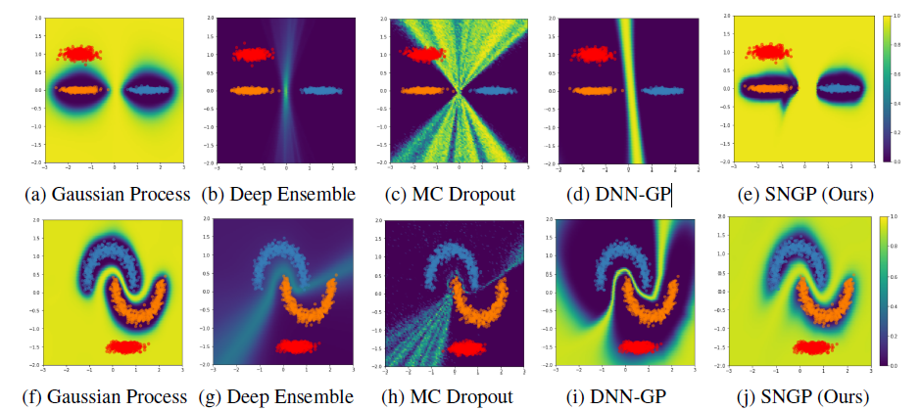
2.4 Comparative Results and Benefits of SNGP
Benefits
It has strong out-of-domain detection performance due to the distance-awareness property.
It works for a wide range of state-of-the-art residual-based architectures.
SNGP has a similar level of latency as a single deterministic network, and can be scaled easily to large datasets.
Downsides
The predictive uncertainty of SNGP is computed using the Laplace approximation, computational complexity of SNGP is slightly increased compared to the normal dense output layer

Slide 31
3.Similarities
Feature | Bayesian Neural Networks | Posterior Network | Repulsive Deep Ensembles | SNGP
Model Type | Single/Ensemble | Single/Ensemble | Ensemble | Single
Main Approach | - Mode traversal - NUTS sampling | - Parameterize the distribution | - Kernelized repulsive terms - Function/weight space interactions | -Distance-preserving Hidden Mapping - Distance-aware Output Layer
Key Techniques | - Exploring connected modes in posterior landscapes | - Normalizing flow - Radial flow and IAF flow | - Introducing repulsive terms in ensembles to maintain diversity | - Combining spectral normalization and Gaussian processes
Strengths | - Efficient exploration of multimodal landscapes | - Effective OOD detection - Robust uncertainty estimation | - Enhanced OOD detection - Improved functional diversity | - Competitive uncertainty estimation and OOD detection - Single-pass inference
Challenges | - Requires multiple chains - Computationally intensive - Hard to scale to large datasets | - Complexity in gradient flow implementation - Requires tuning for best performance | - Possible complexity in kernel choice - Additional repulsive terms tuning | - Assumption of distance-preserving mappings - Computational overhead of GP
Use Cases | - Highly multimodal posterior distributions - Scarce data | - Robust uncertainty estimates and diversity in predictions -OOD detection | - Deep learning tasks requiring diverse ensembles - OOD detection | - Real-time applications needing efficient uncertainty estimation - OOD Detection - Image and language tasks

Slide 32
4.Dataset Interpretation
Notes:
2 minutes per group

Slide 33
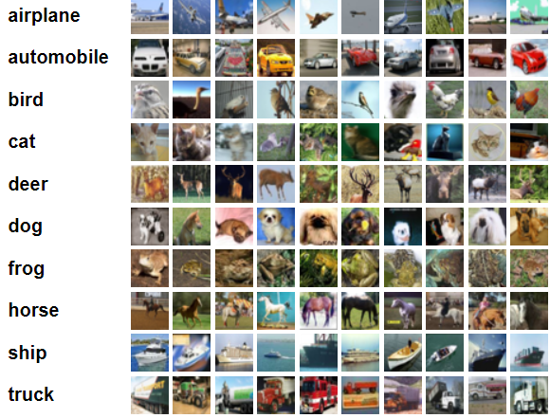
CIFAR10
Developed by Alex Krizhevsky and Geoffrey Hinton
USE: Evaluating computer vision algorithms.
Manageable Dataset size, with real-world images.
CIFAR-10 consists of 60,000 32x32 color images divided into 10 classes, each containing 6,000 images. The classes are airplanes, automobiles, birds, cats, deer, dogs, frogs, horses, ships, and trucks.
It includes a training set of 50,000 images and a testing set of 10,000 images.
Each image is labeled, and the classes are mutually exclusive.
The small image size and low resolution make it harder to distinguish between fine details, and the variability in viewpoints, backgrounds, and object positions adds to the classification difficulty.

Slide 34
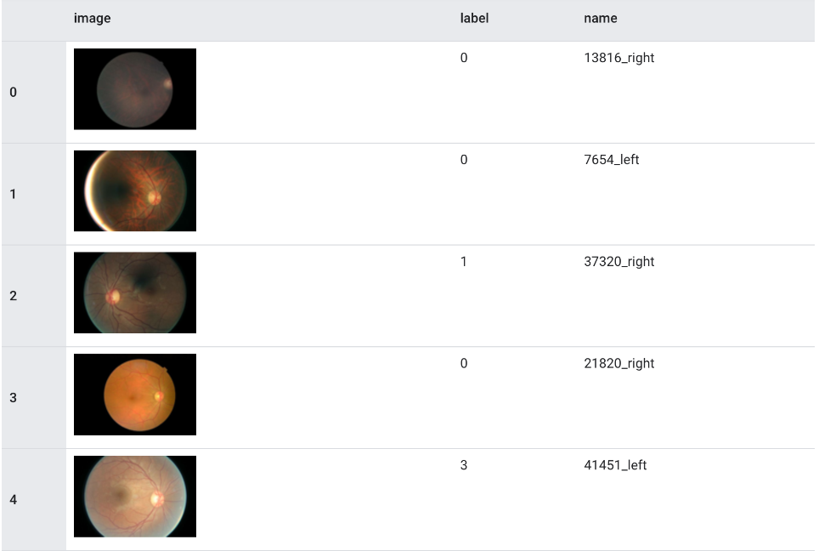
Diabetic Retinopathy
Motivation
- Purpose: To improve early detection and diagnosis of diabetic retinopathy (DR) through automated analysis of retinal images.
- Significance: Early diagnosis can prevent vision loss in diabetic patients.
Overview
Content: RGB retinal images.
Source: Kaggle Diabetic Retinopathy Detection Challenge.
Sample Size:
- Total: 88,702 images.
- Training: 35,126 images.
- Test: 53,576 images.
Resolution: Standardized to 512×512 pixels.
Classification: 5 classes (severity of DR).
0: No DR, 1: Mild DR (not sight threatening)
2: Moderate DR, 3: Severe DR, 4: Proliferative DR
Challenges
Class Imbalance:
-~19% for sight-threatening DR (Class 2,3,4)
-~81% for not sight-threatening DR (Class 0, 1)
Data Quality: Presence of camera artifacts.
Robustness: Testing with APTOS 2019 dataset to handle distribution shifts.

Slide 35
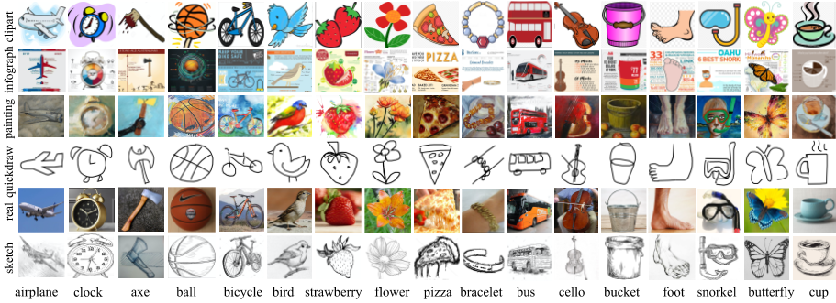
DomainNet
The DomainNet dataset consists of images from six distinct domains, including photos (real), painting, clipart, quickdraw, infograph and sketch.

Slide 36
DomainNet - Motivation and Description
Conventional unsupervised domain adaptation (UDA) assumes that training data are sampled from a single domain. However in a more practical scenario training data is collected from multiple sources, requiring multi-source domain adaptation.
Per domain, there are 48K - 172K images (600K in total) categorized into 345 classes.
Each domain is split into approximately 70% for training and 30% for testing. The labels are available for the test set.

Slide 37
DomainNet
Each domain has a different number of samples and each image has a different dimension/resolution.
Each class has a different number of samples. The dataset has an average of around 150 images per category for clipart and infograph domain, around 220 per category for painting and sketch domain, and around 510 for real domain.
Domain | Images
Photos (real) | 172,947
Painting | 72,266
Clipart | 48,129
Quickdraw | 172,500
Infograph | 51,605
Sketch | 69,128
Challenges
Images have to be resized to a consistent dimension for model training.
Depending on the nature of the task, we could train on domain a,b and test using domain c.
We could evaluate model on a small number of classes and then gradually increase.

Slide 38
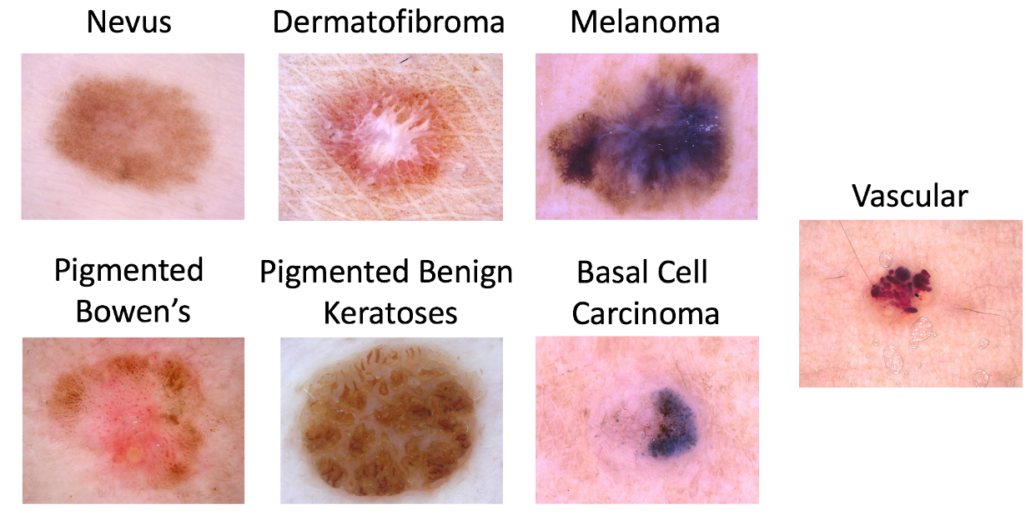
HAM10000
Dataset Overview:
The HAM10000 dataset, known as "Human Against Machine with 10000 training images," is a comprehensive collection of dermatoscopic images used for training neural networks to diagnose pigmented skin lesions.
It includes 10,015 dermatoscopic images sourced from various populations and stored using different modalities, which increases its diversity and utility for machine learning research.
Significance:
This dataset addresses the critical need for large, diverse datasets in the automated diagnosis of skin lesions, offering a robust training set that includes all major diagnostic categories of pigmented skin lesions.
Over 50% of the lesions in the dataset have been verified by pathology, enhancing the reliability of the training data.

Slide 39
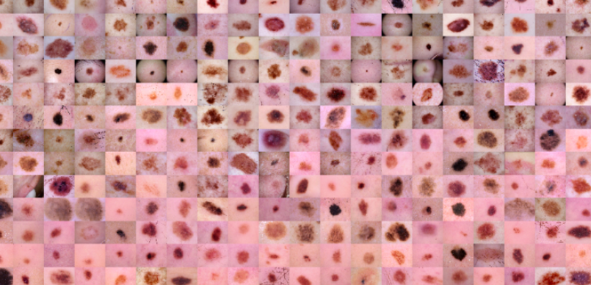
HAM10000
Usage:
HAM10000 is publicly available through the ISIC archive and has been a part of the ISIC 2018 classification challenge.
It serves as a benchmark dataset, allowing for meaningful comparisons between machine learning models and human experts in the field of dermatology.
Unique Aspects:
The dataset incorporates images collected over 20 years from two distinct sites: the Medical University of Vienna and a skin cancer practice in Queensland, Australia.
It includes a variety of image types and conditions, reflecting real-world variability and challenges in diagnosing skin lesions.

Slide 40

Questions

